Slide 1
Regression Analysis Research By: MaKayla Sokoloski

Slide 2
Agenda
Introduction
Methodology
Regression Algorithms
Experimental Results
Analysis
Conclusion
References

Slide 3
Introduction
Comparative Study
Linear
Polynomial
Ridge
Lasso
California House Data
Median House Value
Accuracy and Precision
MSE
R-Squared

Slide 4
Methodology
Dataset: California Housing Project
Import through sklearn library in python
Software: Python
Sklearn, mtplotlib, seaborn, pandas
Metrics: For each model
Mean square error
R-squared values
Notes:
20,640 data points, with 8 features and 1 target – Median House Value

Slide 5
Regression Algorithms
Linear Regression
Strengths: Most widely known, simple and easy to interpret, fast training and prediction, suitable for linear data.
Weaknesses: Assumes a constant linear relationship, sensitive to outliers and multicollinearity.
Implementation Details: Uses Ordinary Least Squares (OLS) for estimation. Can incorporate regularization techniques like Ridge and Lasso to address weaknesses.
Polynomial Regression
Strengths: Captures nonlinear relationships, more flexible than linear regression.
Weaknesses: Prone to overfitting with higher degree polynomials; complexity reduces interpretability.
Implementation Details: Extends linear regression by adding polynomial terms. Can use regularization to help manage overfitting.
Ridge Regression
Strengths: Handles multicollinearity well, more robust towards outliers compared to linear regression.
Weaknesses: Requires careful tuning of the regularization parameter.
Implementation Details: Adds a L2 regularization term to the loss function to improve model stability and handle multicollinearity.
Lasso Regression
Strengths: Performs feature selection by driving some coefficients to zero, effective in high-dimensional datasets.
Weaknesses: Less stable than Ridge, especially when predictors outnumber observations; requires parameter tuning.
Implementation Details: Incorporates a L1 regularization term, which helps in feature reduction and enhances model simplicity.
Notes:
Ridge – penalizes large coefiiecents, multicollinearity - two or more predictor variables in a regression model are highly correlated with each other
Lasso – Least absolute shrinking and selection – Good with large features as it picks the most relevent

Slide 6
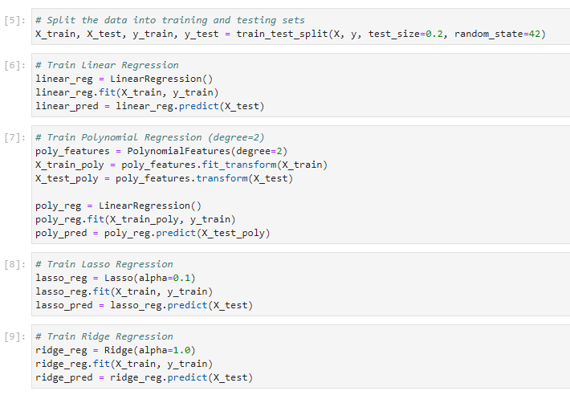
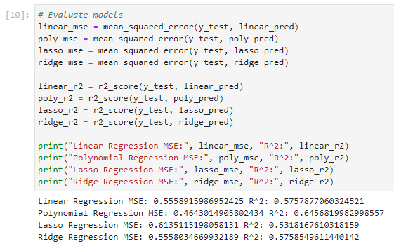
Python Code

Slide 7
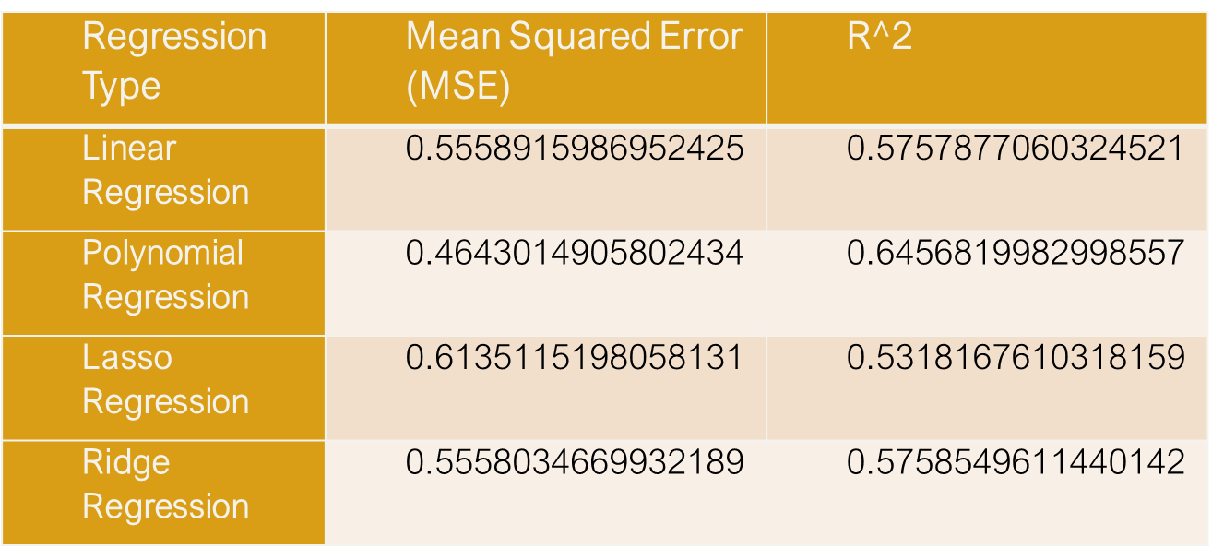
Experimental Results
Comparison of Mean Squared Error and R-squared values for each regression algorithm.
Notes:
MSE =average squared difference between the predicted and actual values. A lower score means the model performed better.
R-squared = proportion of variance in the target variable. The higher this value is the better fit the model is with 1 being a perfect fit.

Slide 8
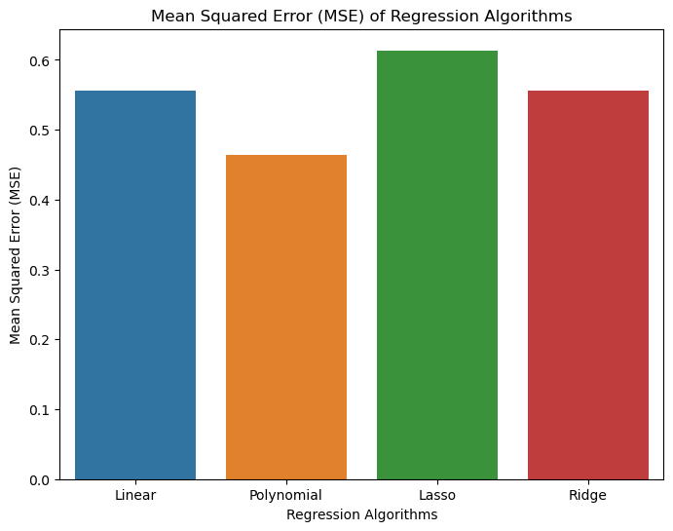
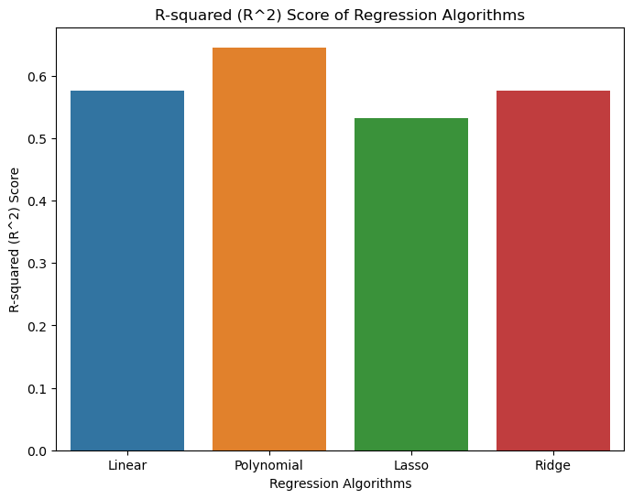
Visualization
Notes:
MSE
Smallest Values = less difference in predicted value
R-Squared
Larger Values = Less Variance from best fit line

Slide 9
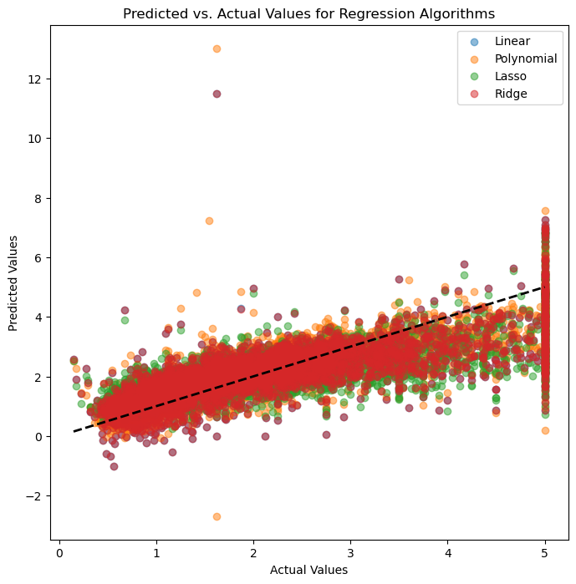
Results
Scatter plot
Predicted value vs Actual value
Color – Algorithm
Show general path of how each predicted

Slide 10
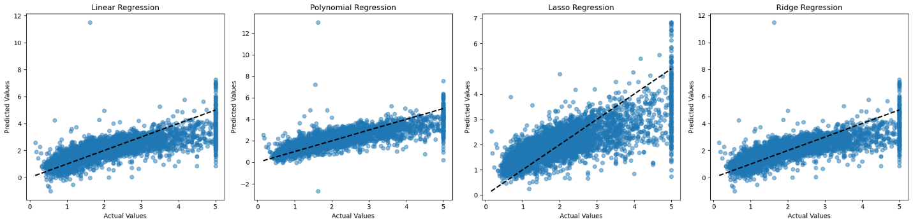
Results – Spread Out
Scatter plot
Predicted value vs Actual value
Frame – algorithm
Show general path of how each predicted
Shows the difference in best-fit line
Follows most closely with polynomial
Least with Lasso
Ridge and linear are very similar almost identical

Slide 11
Analysis
Polynomial Regression
Performance: Best among the models, with the lowest Mean Squared Error (MSE) approximately 0.464 and the highest R-squared (R²) approximately 0.646.
Observation: Suggests a probable non-linear relationship in the dataset; polynomial features significantly enhance predictions.
Linear Regression
Performance: Shows moderate performance; like Ridge Regression in terms of metrics.
Observation: Provides a baseline for comparison with other models.
Ridge Regression
Performance: Like to Linear Regression in terms of MSE and R².
Observation: Regularization provided by Ridge does not significantly improve performance over Linear Regression for this dataset.
Lasso Regression
Performance: Performs the worst among the models.
Observation: Feature selection, which drives some coefficients to zero, does not provide benefits for this dataset, indicating that all features may be relevant.

Slide 12
Discussion
Polynomial Regression
Strengths: Capturing Nonlinear Relationships: Best performance with the lowest MSE and highest R², showing strong capability to model complex patterns.
Weaknesses: Prone to Overfitting: Vulnerability increases with higher polynomial degrees, potentially fitting noise rather than signal.
Linear Regression
Strengths: Simplicity and Interpretability: Easy to understand and implement; provides clear insights into the relationship between variables.
Weaknesses: Limited Flexibility: Assumes linear relationships, struggling with complexity and nonlinearity in the dataset.
Ridge Regression
Strengths: Handling Multicollinearity: Adds a penalty to the loss function to manage multicollinearity, enhancing model robustness.
Weaknesses: Requires Tuning of Regularization Parameter: Needs precise adjustment of lambda to balance model accuracy and complexity.
Lasso Regression
Strengths: Feature Selection: Automatically reduces dimensionality by setting less important coefficients to zero, which can simplify the model.
Weaknesses: Struggles with Correlated Features: May become unstable or perform poorly when features are highly correlated.

Slide 13
Conclusion
Polynomial Regression is preferred for its accuracy in modeling complex relationships, despite risks of overfitting.
01
Linear Regression offers a baseline with good interpretability but limited application scope due to its simplicity.
02
Ridge and Lasso Regressions provide valuable tools for handling multicollinearity and feature selection, respectively, though each requires careful parameter tuning to maximize performance.
03

Slide 14

Questions?

Slide 15
References
Basumatary, D. R. (2023, July 17). Implementing Linear Regression on California Housing Dataset. Retrieved from Medium: https://medium.com/@basumatary18/implementing-linear-regression-on-california-housing-dataset-378e14e421b7
Jain, A. (2024, January 11). Ridge and Lasso Regression in Python | Complete Tutorial (Updated 2024). Retrieved from Analytics Vidhya: https://www.analyticsvidhya.com/blog/2016/01/ridge-lasso-regression-python-complete-tutorial/#:~:text=Ridge%20and%20Lasso%20Regression%20are,hyperparameter%20tuning%20and%20cross%2Dvalidation.
SciKit. (2024). API Reference. Retrieved from SciKit Learn: https://scikit-learn.org/stable/modules/classes.html

